Slide 3
OUTLINE
Risk and Return of a Single Asset
Risk and Return of a Portfolio
Measurement of Market Risk
Relationship between Risk and Return

Slide 4
RISK AND RETURN OF A SINGLE ASSET
RATE OF RETURN
Annual income + Ending price-Beginning price
Rate of Return =
Beginning price Beginning price
Current yield Capital gains yield
Probability Distributions
State of the Probability of Bharat Foods Oriental Shipping Economy Occurrence
Boom 0.30 25 50
Normal 0.50 20 20
Recession 0.20 15 -10

Slide 5
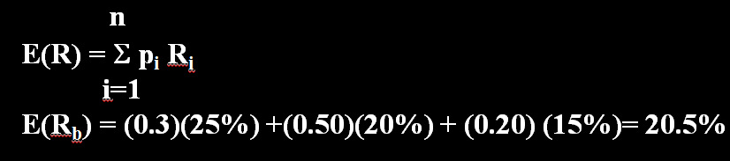
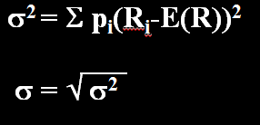
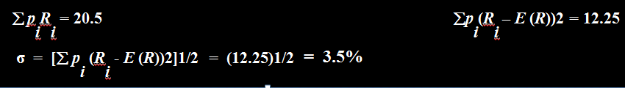
RISK AND RETURN OF A SINGLE ASSET
EXPECTED RATE OF RETURN
STANDARD DEVIATION OF RETURN
State of the Bharat Foods Stock
Economy ^{p}_{i} ^{R}_{i} ^{p}_{i}^{R}_{i} ^{R}_{i}^{- E(R) (R}_{i}^{- E(R))2 p}_{i}^{(R}_{i}^{- E(R))2}
1. Boom 0.30 25 7.5 4.5 20.25 6.075
2. Normal 0.50 20 10.0 -0.5 0.25 0.125
3. Recession 0.20 0.20 15 3.0 -5.5 30.25 6.050

Slide 6
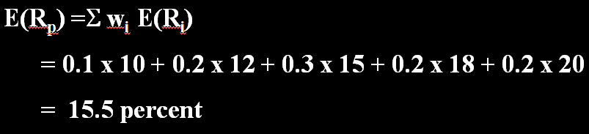
EXPECTED RETURN ON A PORTFOLIO

Slide 7
DIVERSIFICATION AND PORTFOLIO RISK
Probability Distribution of Returns
State of the Probability Return on Return on Return on
Economy Stock A Stock B Portfolio
1 0.20 15% -5% 5%
2 0.20 -5% 15 5%
3 0.20 5 25 15%
4 0.20 35 5 20%
5 0.20 25 35 30%
Expected Return
Stock A : 0.2(15%) + 0.2(-5%) + 0.2(5%) +0.2(35%) + 0.2(25%) = 15%
Stock B : 0.2(-5%) + 0.2(15%) + 0.2(25%) + 0.2(5%) + 0.2(35%) = 15%
Portfolio of
A and B : 0.2(5%) + 0.2(5%) + 0.2(15%) + 0.2(20%) + 0.2(30%) = 15%
Standard Deviation
Stock A : σ²_{A} = 0.2(15-15)² + 0.2(-5-15)² + 0.2(5-15)² + 0.2(35-15)² + 0.20 (25-15)²
= 200
σ_{A} = (200)^{1/2} = 14.14%
Stock B : σ²_{B} = 0.2(-5-15)² + 0.2(15-15)² + 0.2(25-15)² + 0.2(5-15)² + 0.2 (35-15)²
= 200
σ_{B} = (200)^{1/2} = 14.14%
Portfolio : σ²_{(A+B)} = 0.2(5-15)² + 0.2(5-15)² + 0.2(15-15)² + 0.2(20-15)² + 0.2(30-15)²
= 90
σ_{A+B} = (90)^{1/2} = 9.49%

Slide 8
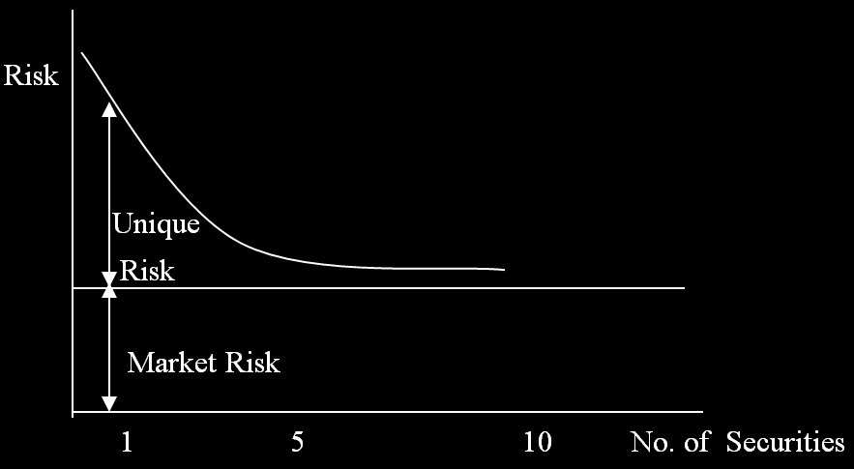
RELATIONSHIP BETWEEN DIVERSIFICATION AND RISK

Slide 9
MARKET RISK VS UNIQUE RISK
Total Risk = Unique risk + Market risk
Unique risk of a security represents that portion of its total risk which stems from company-specific factors.
Market risk of security represents that portion of its risk which is attributable to economy –wide factors.

Slide 10
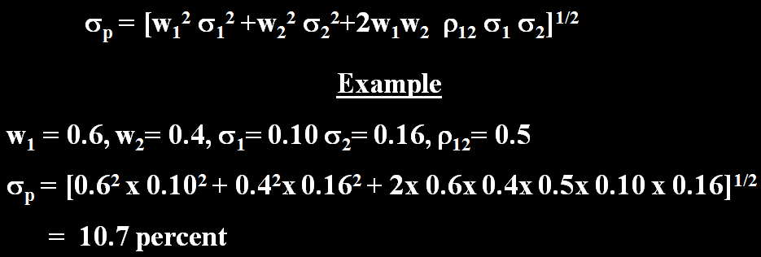
PORTFOLIO RISK THE 2-SECURITY CASE

Slide 11
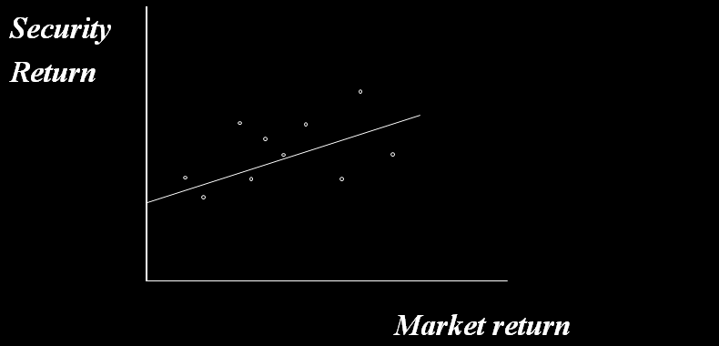
MEASUREMENT OF MARKET RISK
The sensitivity of a security to market movements is called beta.
Beta reflects the slope of a the linear regression relationship between the return on the security and the return on the portfolio.
Relationship between Security Return and Market Return

Slide 12
RECAPITULATION OF THE STORY SO FAR
Securities are risky because their returns are variable.
The most commonly used measure of risk or variability in finance is standard deviation.
The risk of a security can be split into two parts: unique risk and market risk.
Unique risk stems from firm-specific factors, whereas market risk emanates from economy-wide factors.
Portfolio diversification washes away unique risk, but not market risk.
Hence, the risk of a fully diversified portfolio is represented by its market risk.
The contribution of a security to the risk of a fully diversified portfolio is measured by its beta, which reflects its sensitivity to the general market movements.

Slide 13
CAPITAL ASSET PRICING MODEL (CAPM)
EXPECTED RATE OF RISK-FREE RATE OF RISK
RETURN RETURN PREMIUM
RISK PREMIUM = BETA [EXPECTED RETURN ON MARKET PORTFOLIO – RISK FREE RATE OF RETURN]
Example
Beta = 1.20
Expected return on the market portfolio = 15 percent
Risk free rate = 10 percent
Expected rate of return = 10 +1.2 (15-10)
= 16 percent
=
+

Slide 14
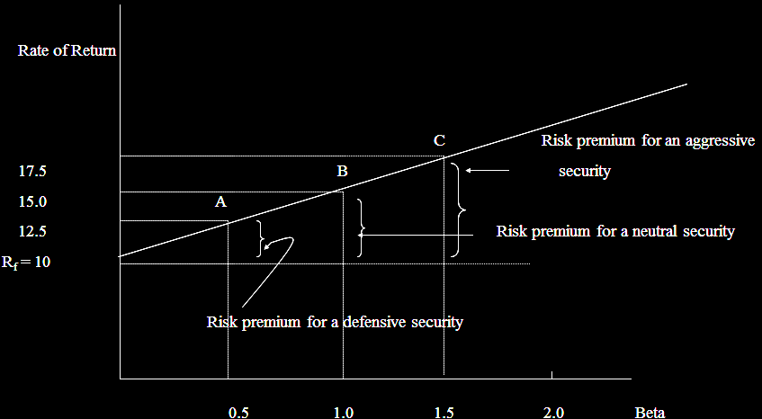
BETA (MARKET RISK) & EXPECTED RATE OF RETURN

Slide 15
IMPLICATIONS
Diversification is important . Owning a portfolio dominated by a small number of stocks is a risky proposition.
While diversification is desirable , an excess of it is not. There is hardly any gain in extending diversification beyond 10 to 12 stocks.
The performance of well –diversified portfolio more or less mirrors the performance of the market as a whole.
In a well ordered market, investors are compensated primarily for bearing market risk,but not unique risk. To earn a higher expected rate on return, one has to bear a higher degree of market risk.

Slide 16
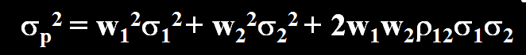
SUMMING UP
Variance (a measure of dispersion) or its square root, the standard deviation, is commonly used to reflect risk
The variance is defined as the average squared deviation of each possible return from its expected value.
Diversification reduces risk, but at a diminishing rate
According to the modern portfolio theory:
The unique risk of a security represents that portion of its total risk which stems from firm-specific factors.
The market risk of a security represents that portion of its risk which is attributable to economy wide factors.
The variance of the return of a two-security portfolio is:

Slide 17
SUMMING UP
Portfolio diversification washes away unique risk, but not market risk. Hence the risk of a fully diversified portfolio is its market risk.
The contribution of a security to the risk of a fully diversified portfolio is measured by its beta, which reflects its sensitivity to the general market movements.
According to the capital asset pricing model, risk and return are related as follows:
Expected rate = Risk-free rate
Expected return on Risk-free
market portfolio – rate
In a well-ordered market, investors are compensated primarily for bearing market risk, but not unique risk. To earn a higher expected rate of return, one has to bear a higher degree of market risk.
+ Beta of the security

